Slide 1

Bean & GONE
wireframes

Slide 2

COFFEE SHOP
In-store & Online experience
Informational and e-commerce pages:
In-store menu
Subscription options
Coffee appliances & merchandise
Wholesale
Serving three types of customers
Cuppa Joe
Flat White Fred
Wholesale Helen

Slide 3



Logos & Branding

Slide 4
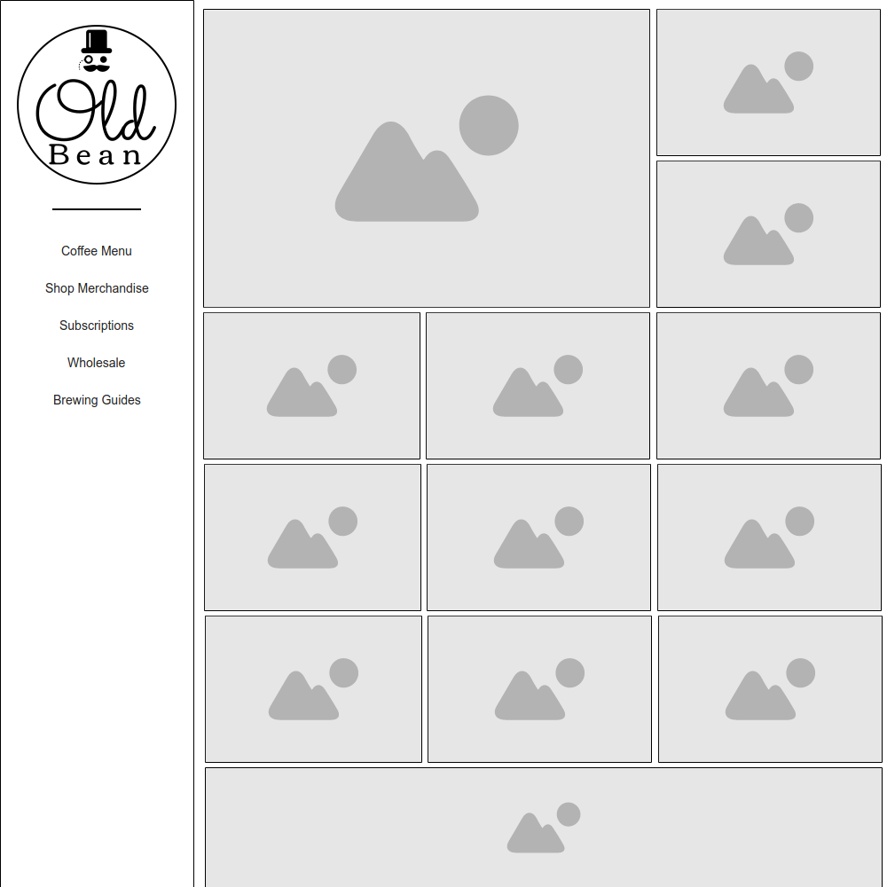
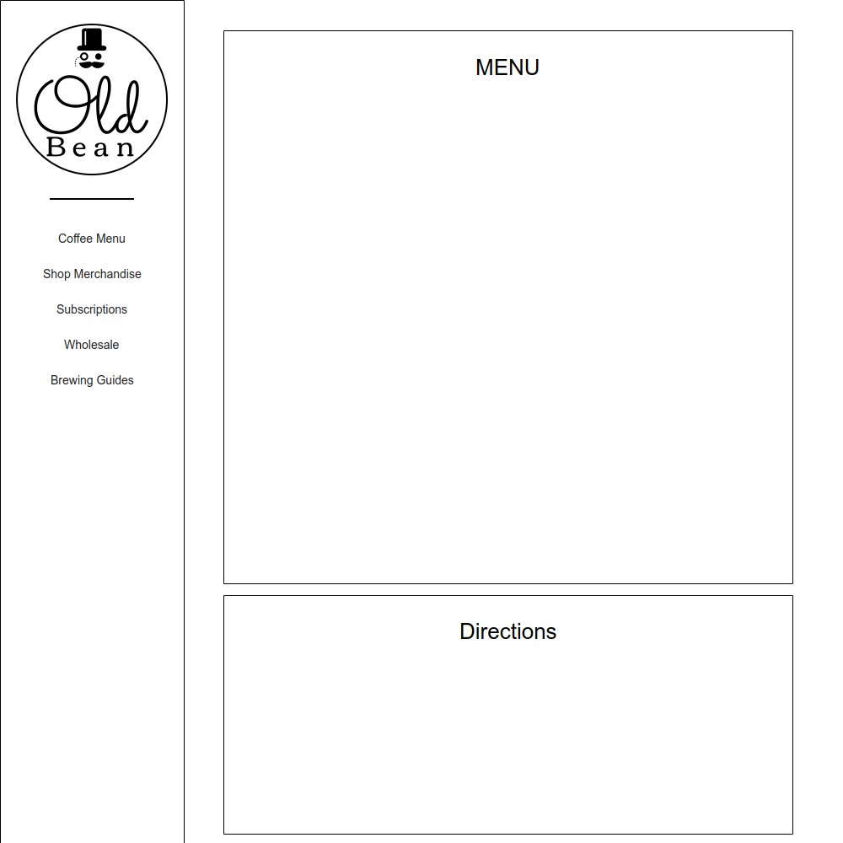
Index & MENU

Slide 5
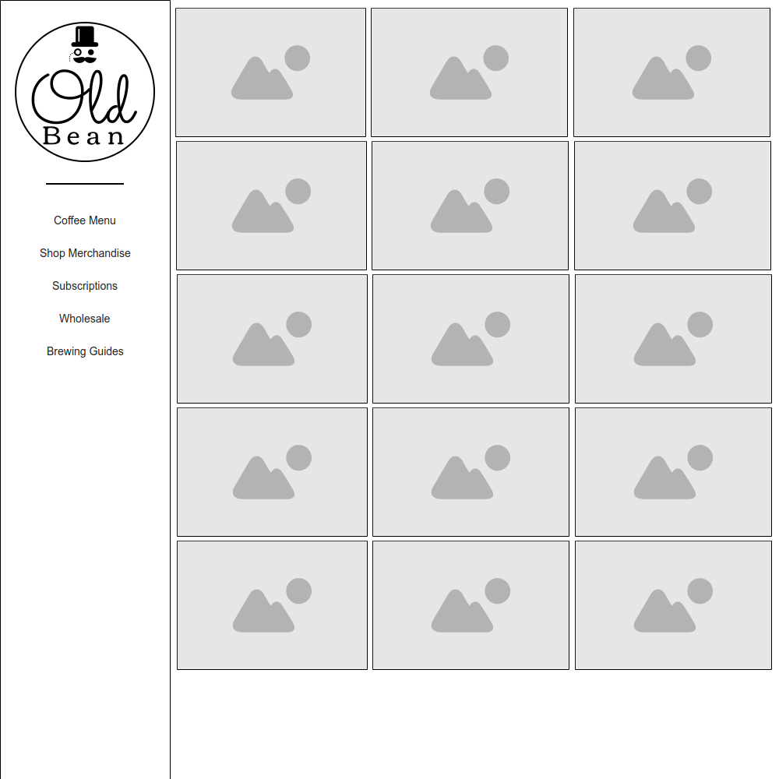
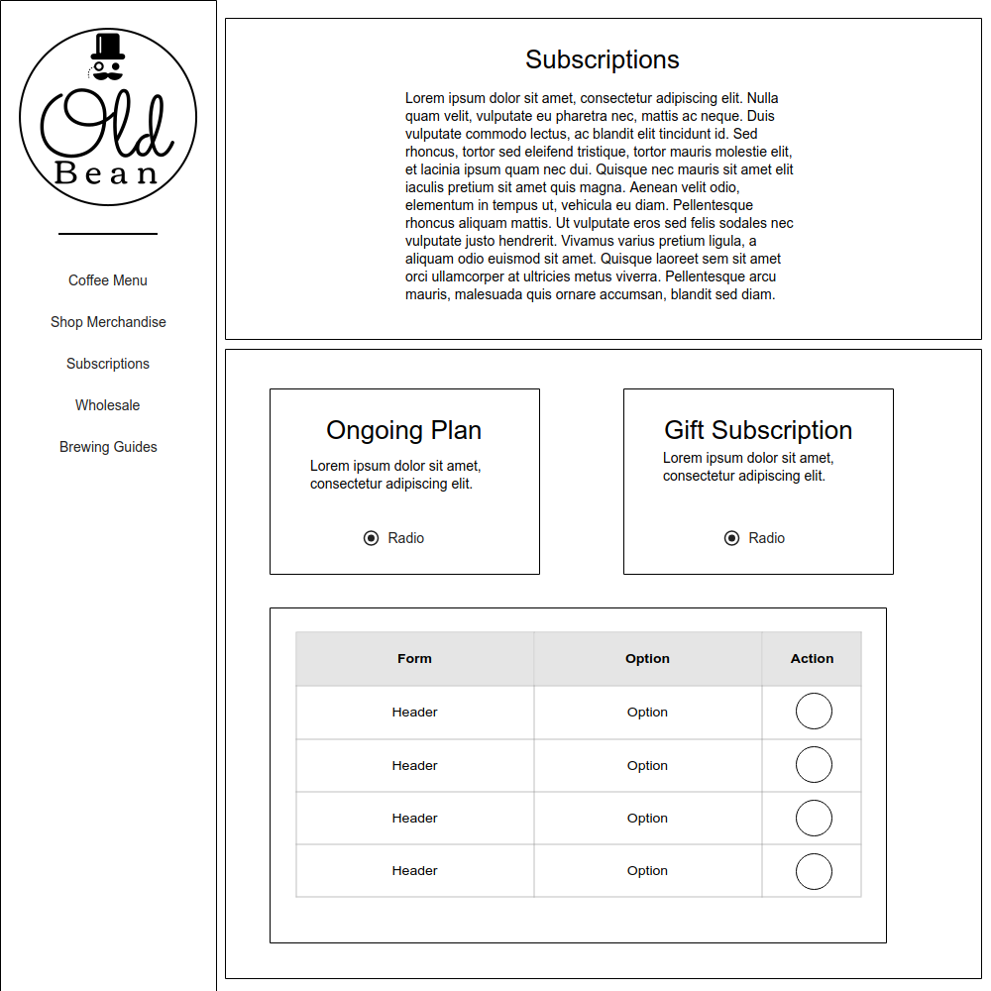
MERCHANDISE & SUBSCRIPTION

Slide 6
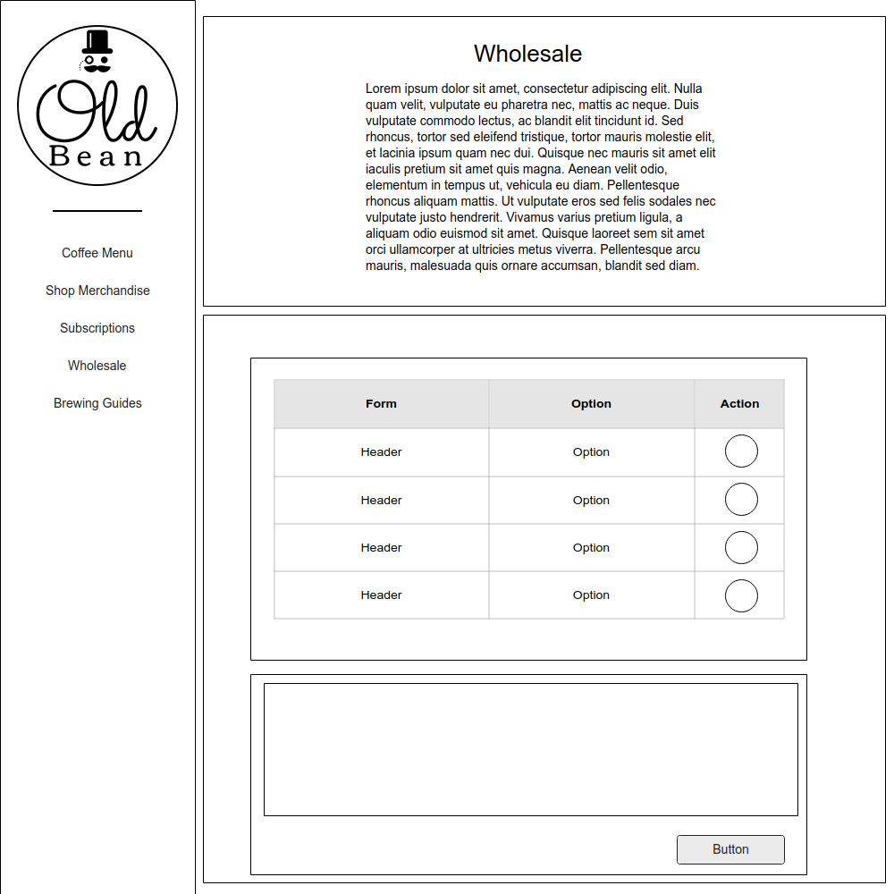
WHOLESALE

Slide 7
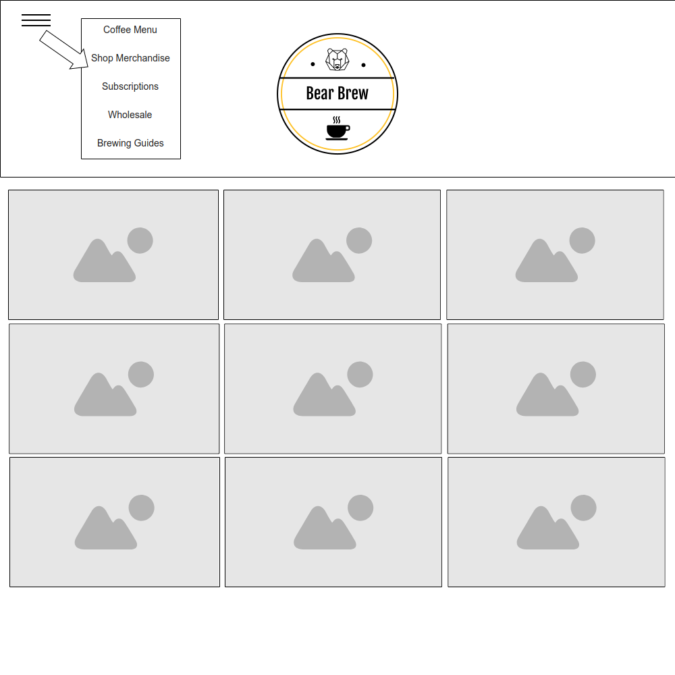
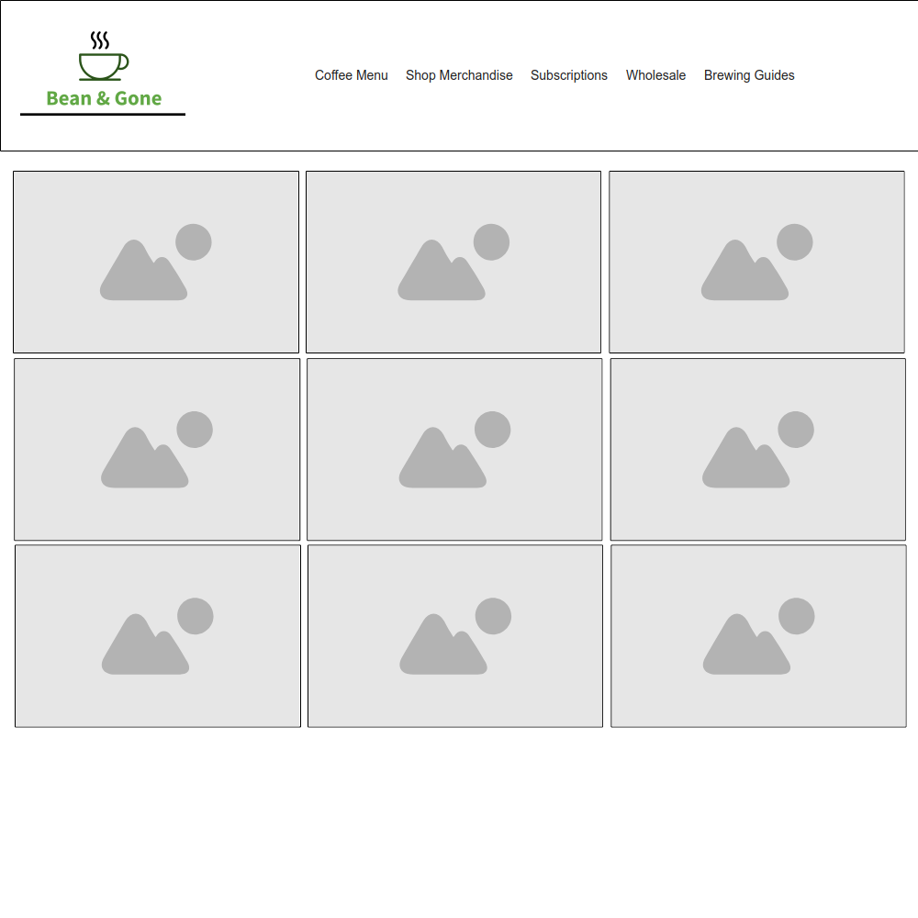
MERCHANDISE & SUBSCRIPTION

Slide 8
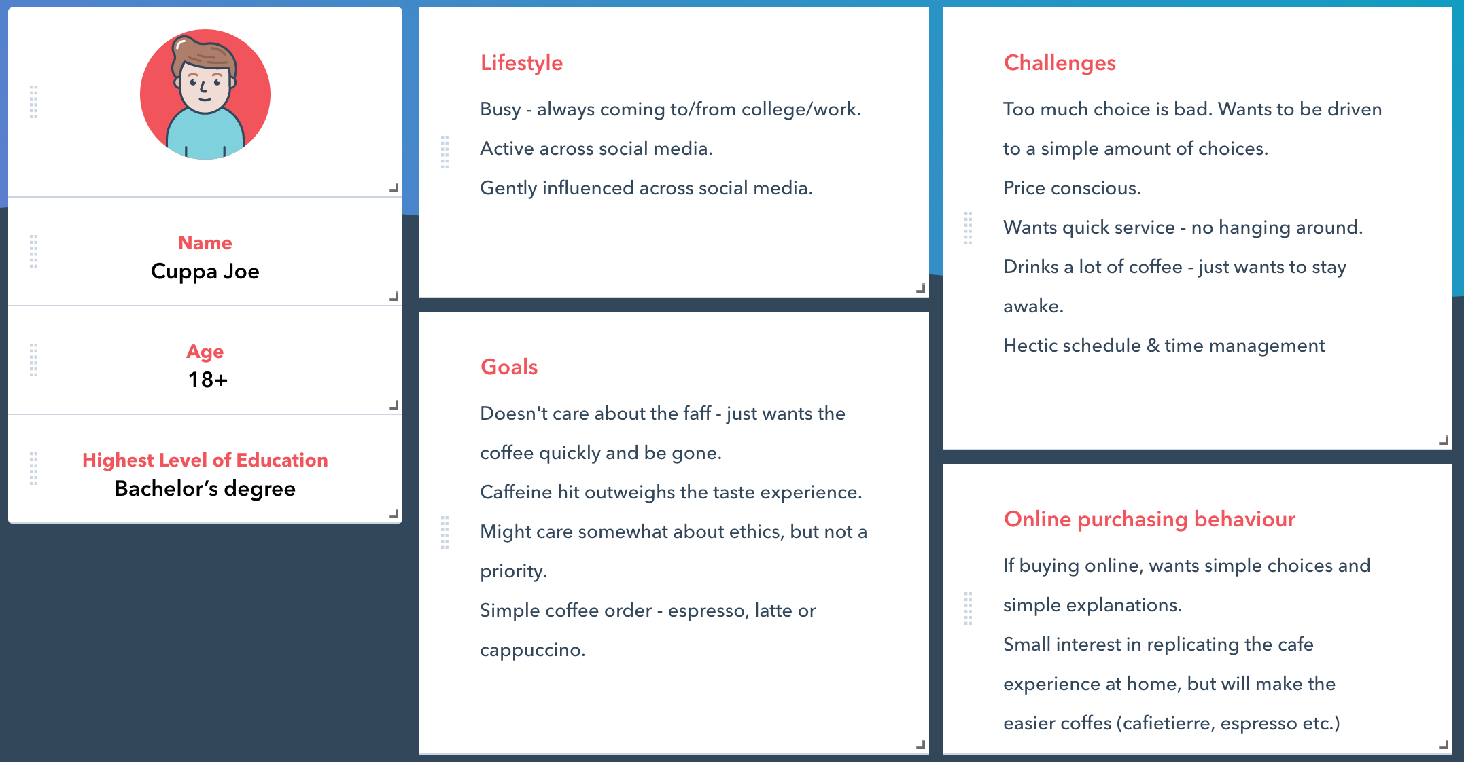
PERSONA – CUPPA JOE

Slide 9
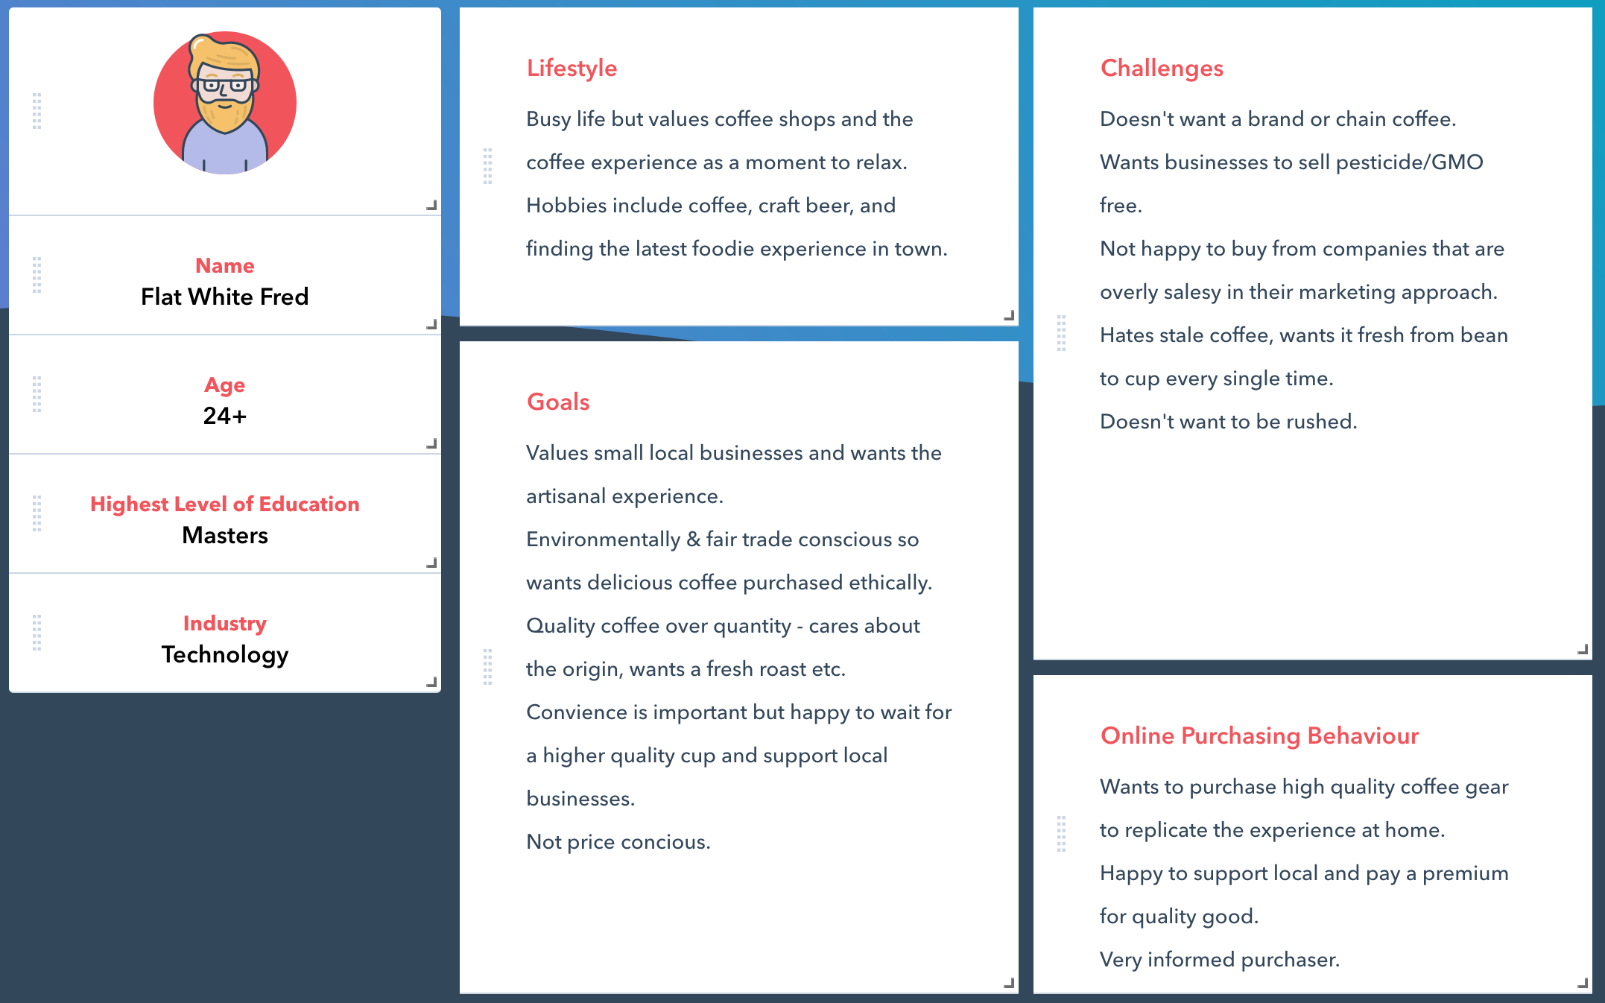
PERSONA – FLAT WHITE FRED

Slide 10
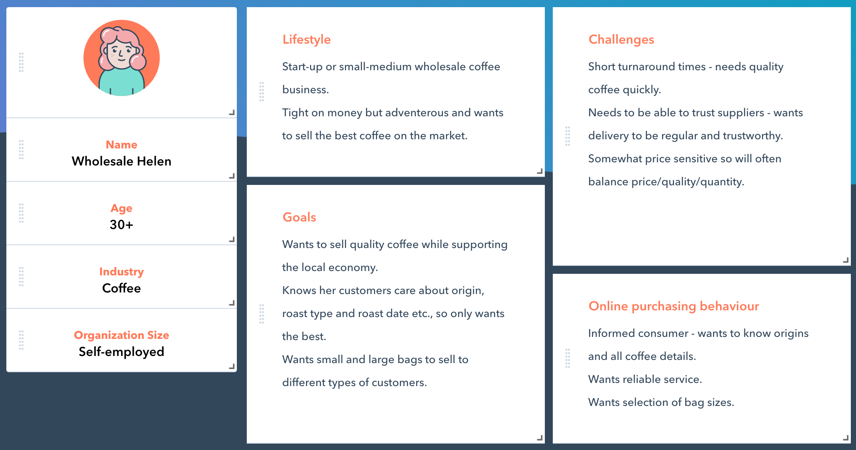
PERSONA – WHOLESALE HELEN

Slide 11
Sitemap
Bean & Gone
About
Subscriptions
Coffee Menu
Coffee Merchandise
Wholesale

